Slide 1
Introduction and Methods
Prof Tim Cook
Royal United Hospital, Bath
College Advisor to the NAPs

Slide 2
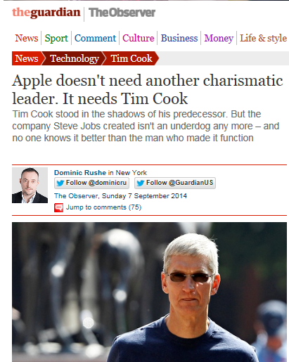

Slide 3
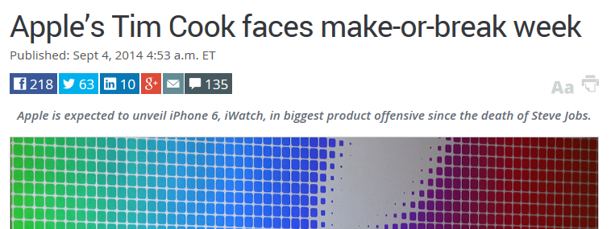
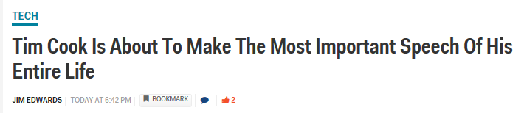
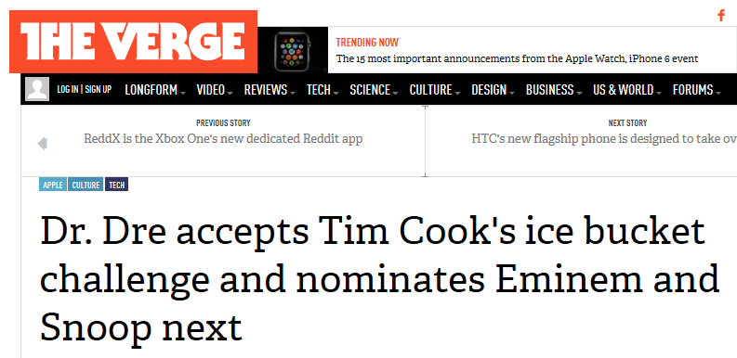

Slide 4
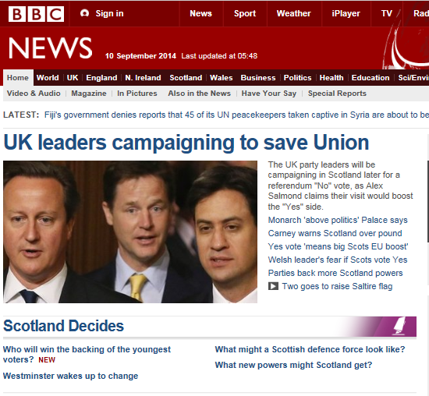
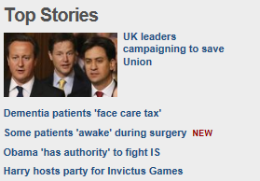
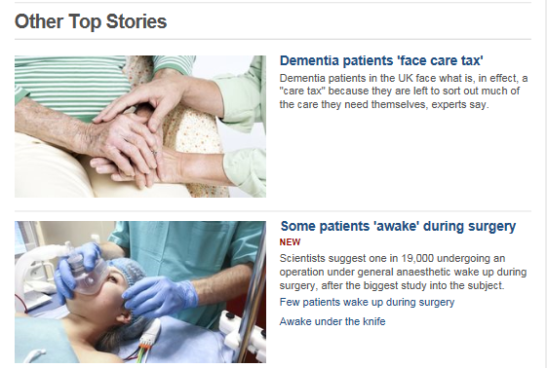

Slide 5
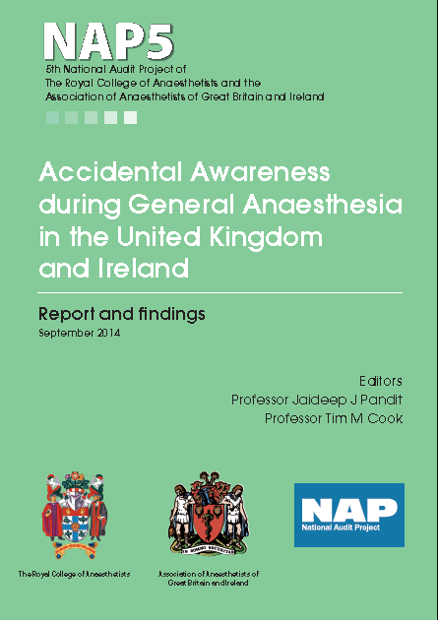

Slide 6
The day
Program
Timelines tight
Ample question time
Drinks
On line

Slide 7
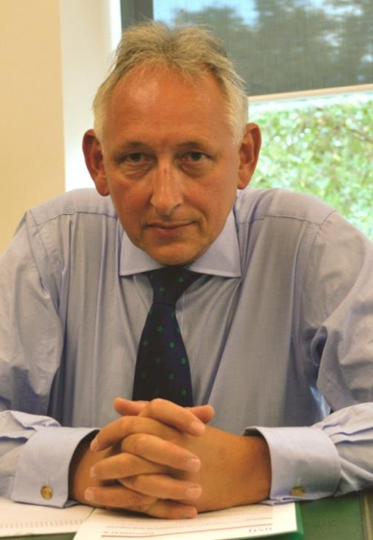




Slide 8
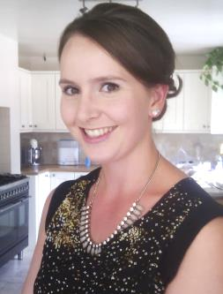
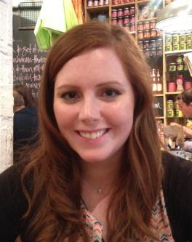
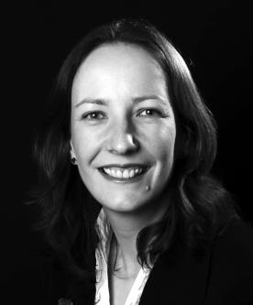
Thanks
Maddy Mary Sharon
Humphreys Casserley Drake

Slide 9
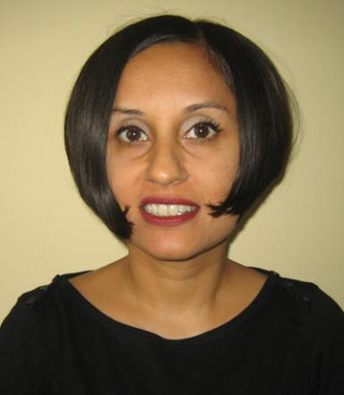
Thanks
Anamika Trivedi

Slide 10
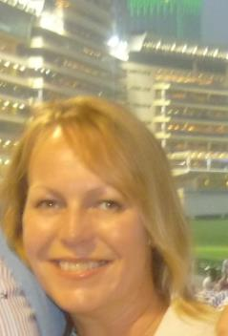
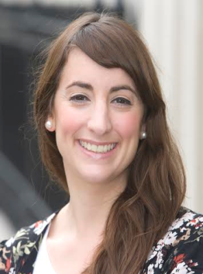
Thanks
Sonia Larsen
media RCoA
Nicole Bates
media AAGBI

Slide 11
Thanks
All anaesthetists
UK and Ireland

Slide 12
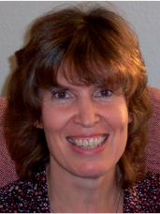
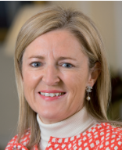
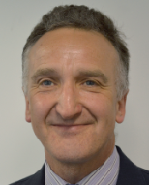


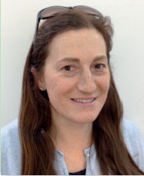
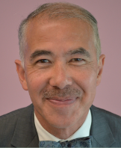

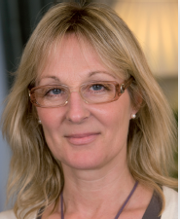
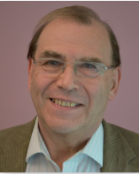
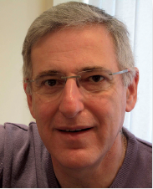
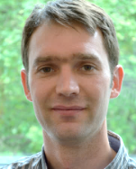



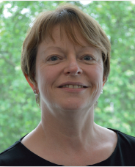


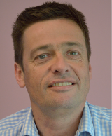
Thanks - panel
Panel

Slide 13


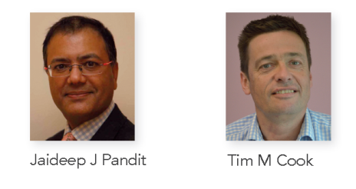

Slide 14
Timeline
2011-2
Topic chosen
Jaideep appointed
Approvals, CMO endorsement, website
2012-13
Case collection
Cases close
2013-14
Analysis
Synthesis
Publication…dissemination…..implementation

Slide 15
Workstreams
Baseline survey
Irish baseline survey
Irish activity survey
UK activity survey
(SNAP-1 Brice days)
Academic launch
Artistic event
Psychological follow-up

Slide 16
Methods
Broadly as for NAP3, NAP4
- All UK NHS hospitals
Service evaluation
I year registry
New for NAP5
- Inclusion of Ireland
- Negative reporting
- Collaboration AAGBI + RCoA

Slide 17
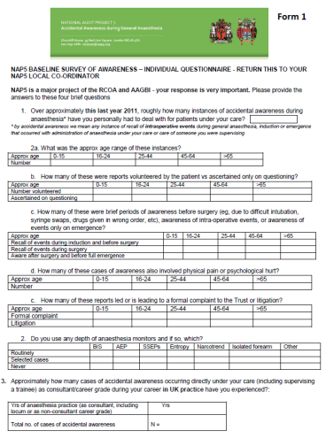
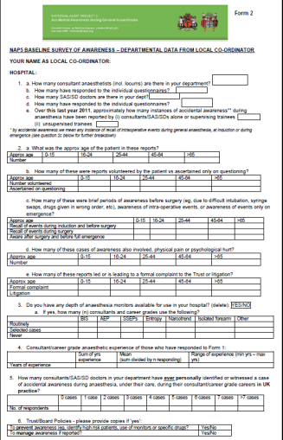
Individual and department forms
Baseline survey

Slide 18
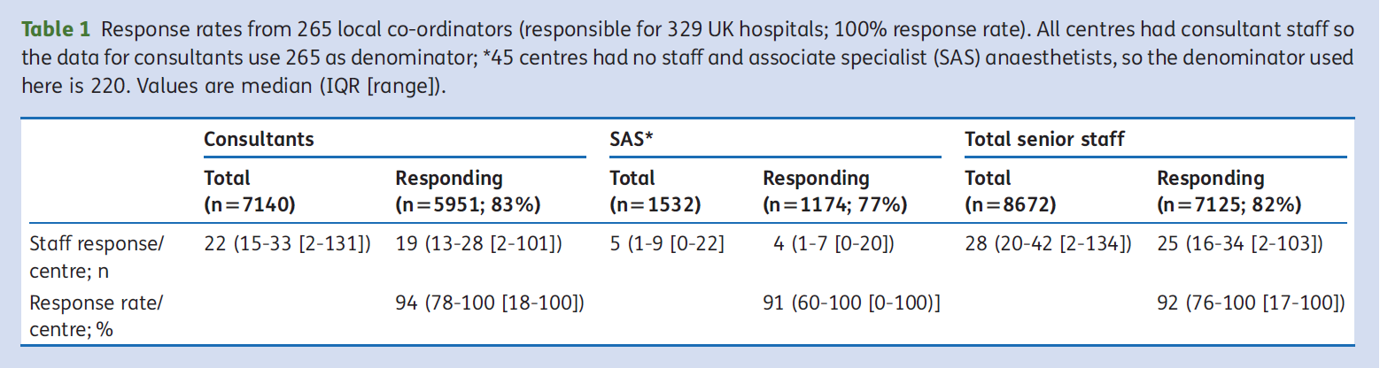
Data from 100% UK hospitals
Replies from 92% senior UK anaesthetists

Slide 19
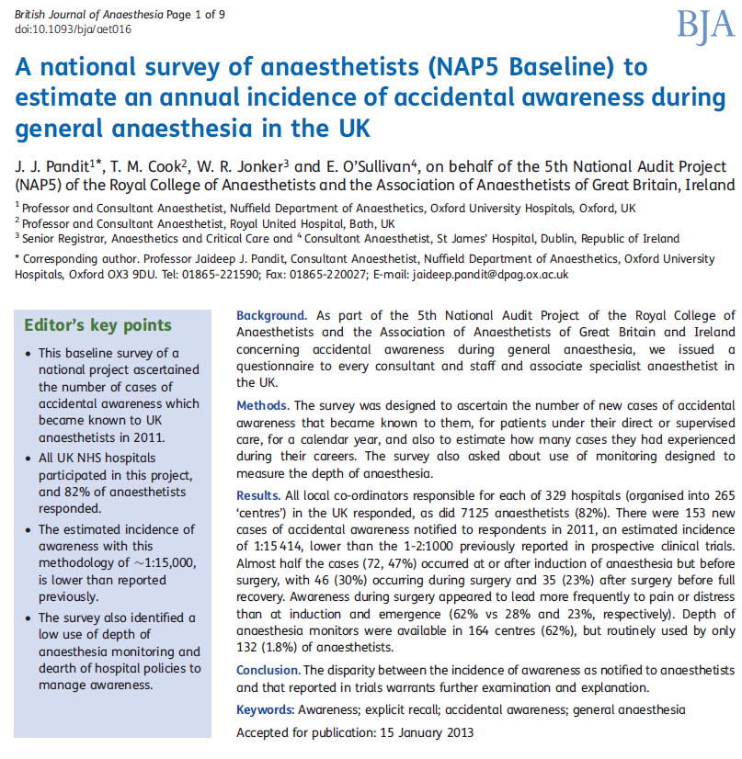
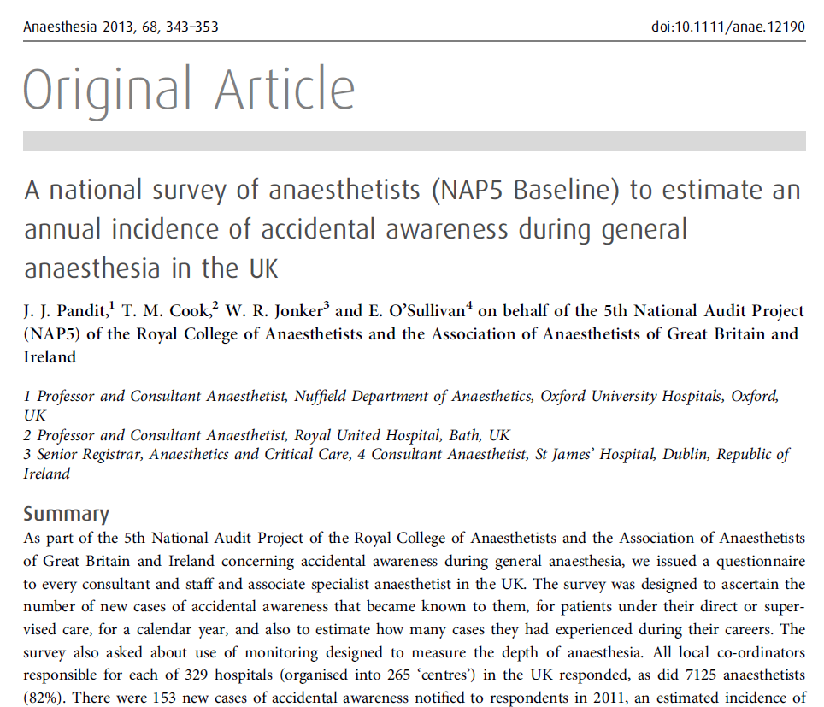
April
2013

Slide 20
April
2013
153 reports of AAGA in 2011
Reports ≈ 1:15,000 GAs
Limited use of DOA
Minimal AAGA pathways

Slide 21


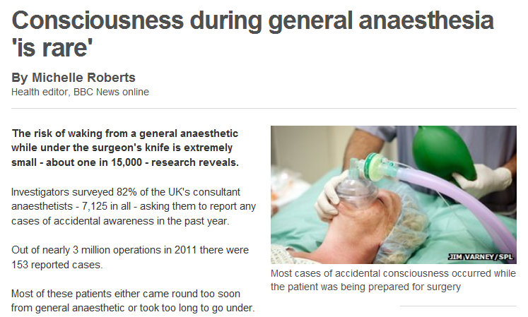
>100 website reports
http://www.bbc.co.uk/news/health-21742306

Slide 22

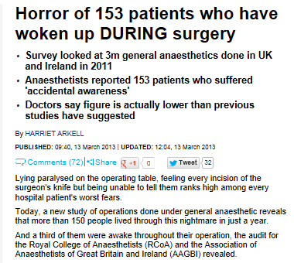


Slide 23
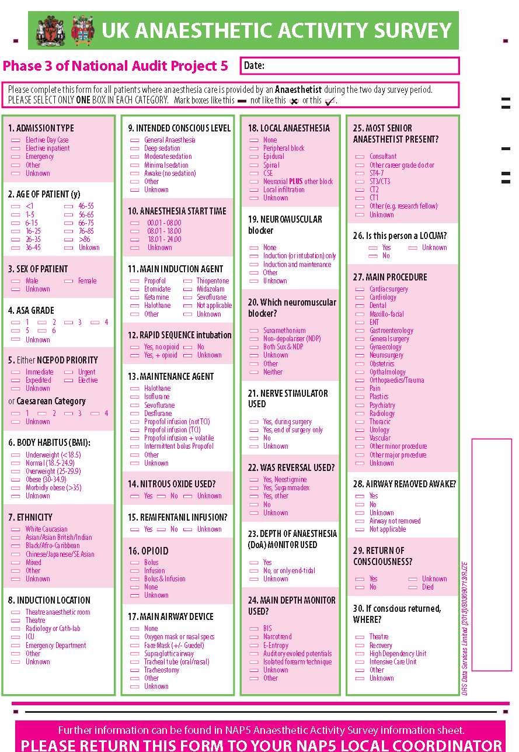
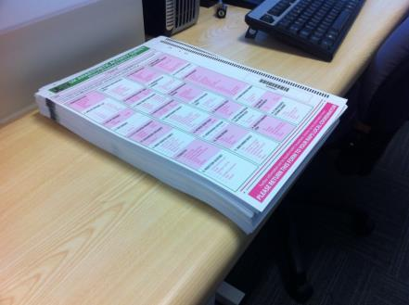
UK Activity survey

Slide 24
UK Activity survey
100% returns
>20,000 cases

Slide 25
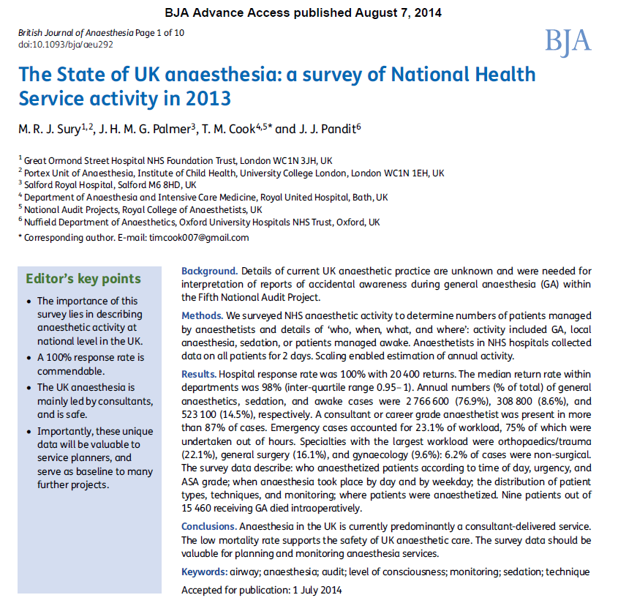
NAP5 denominator

Slide 26
SNAP1 - BRICE survey
March 2014
Satisfaction
‘Once Brice’
Up to 20,000

Slide 27
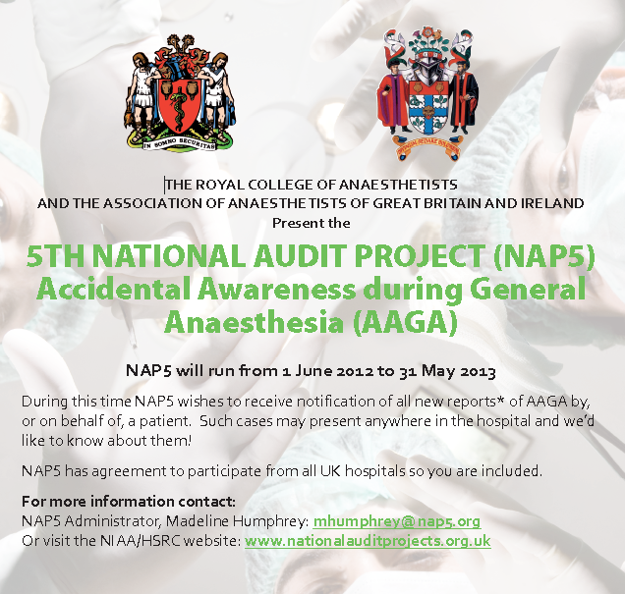

Slide 28
Inclusion criteria
a new patient report
made between 1 June 2012 - 31 May 2013
that they had been aware for a period of time when they expected to be unconscious.

Slide 29
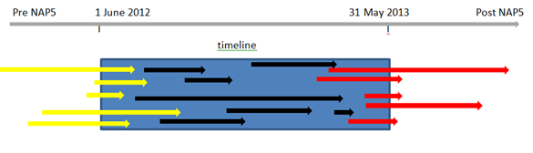
Historical cases captured to balance future missed cases

Slide 30
The NAP firewall
i Anonymous report to administrator
ii Verification questions
iii Automated remote release of username and password
iv Mandated password change at first log on
v Report to secure, encrypted website (no identifiers)
vi Completed report mailed to NAP lead
vii Screening of reports for identifiers
Vii Report for review

Slide 31
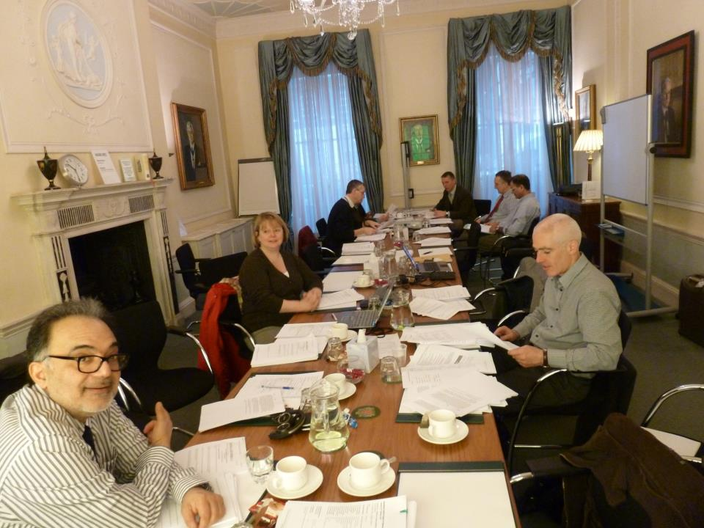

Slide 32
NAP5 panel
Including …..
  Patient representatives
  President AAGBI
  2 council members RCoA
  3 council members AAGBI
  President CAI
  Editor-in-Chief BJA
  President SIVA
  President OAA
  Psychologists, psychiatrists
  5 Profs etc etc

Slide 33
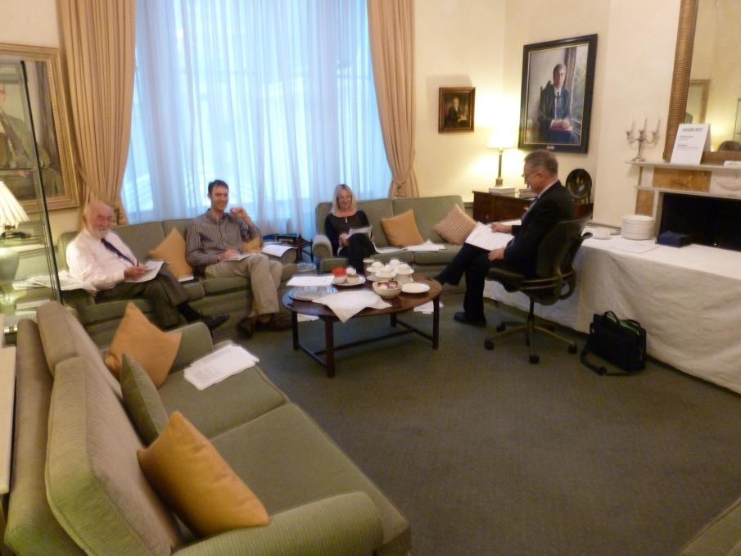

Slide 34
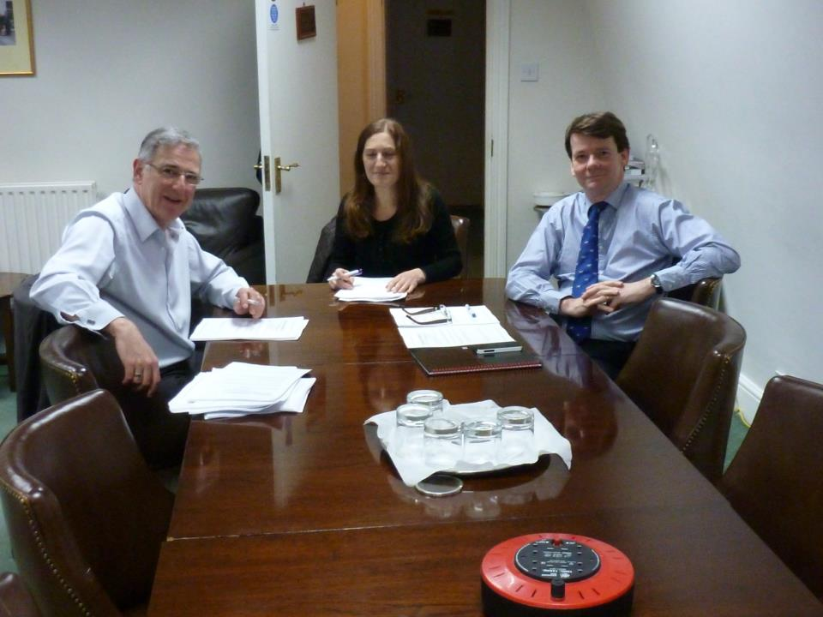

Slide 35
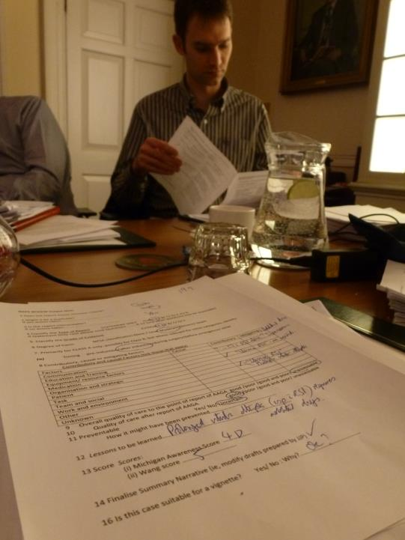

Slide 36
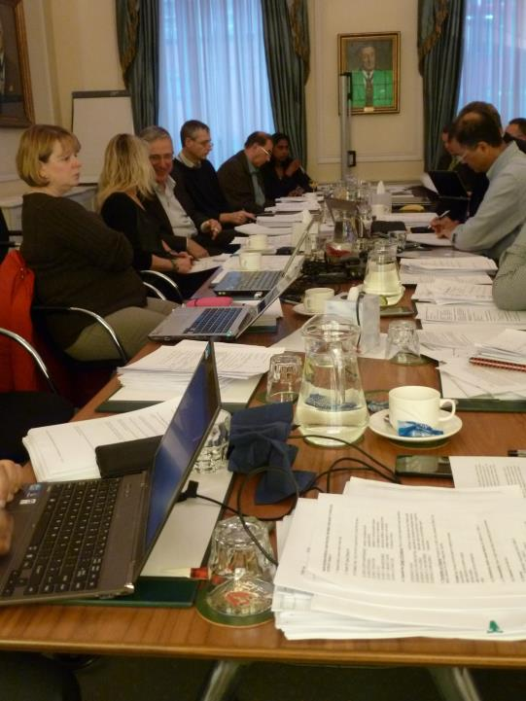

Slide 37
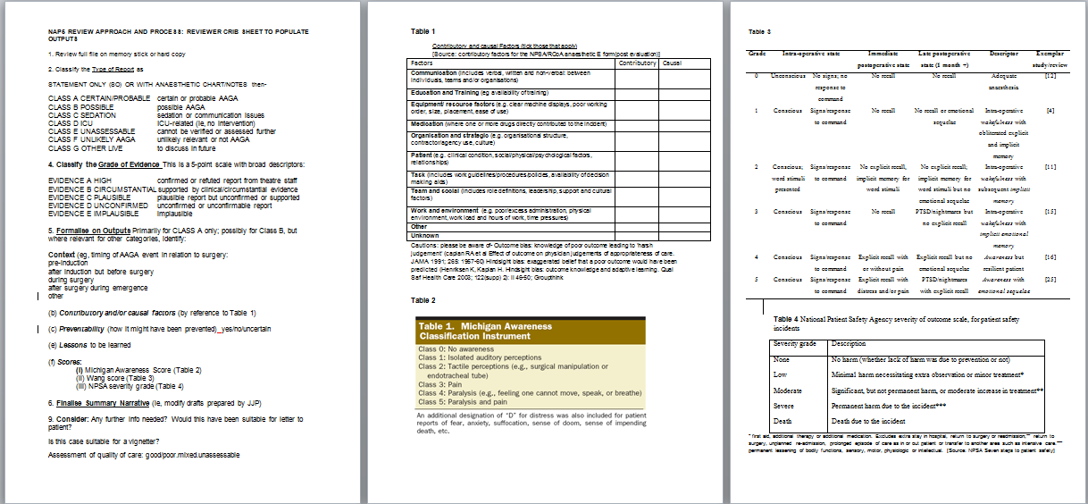
Structured outputs

Slide 38
Aware of…..
Outcome bias: knowledge of poor outcome leading to ‘harsh judgement’
  Caplan RA et al Effect of outcome on physician judgements of appropriateness of care. JAMA 1991; 265: 1957-60
Hindsight bias: exaggerated belief that a poor outcome would have been predicted
  Henriksen K, Kaplan H. Hindsight bias: outcome knowledge and adaptive learning. Qual Saf Health Care 2003; 122(supp) 2): ii 46-50.
‘Group think’

Slide 39
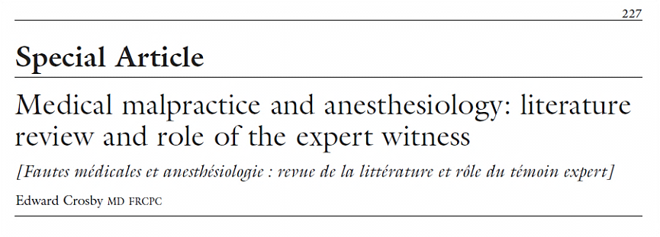

Review process

Slide 40
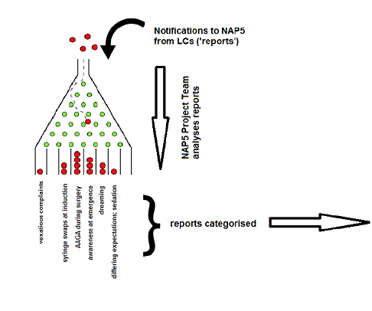

Slide 41


Slide 42
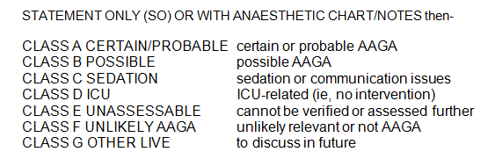
Classification: Type of AAGA

Slide 43
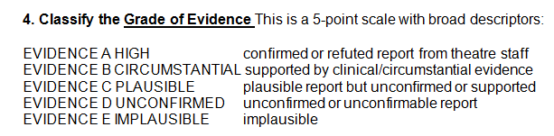
Classification: Evidence

Slide 44
Classification: patient experience

Slide 45
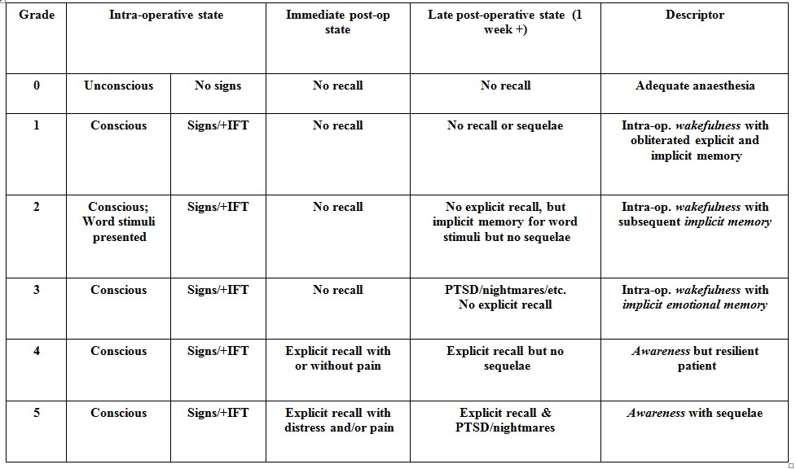
Classification: patient experience
Wang M. 2009

Slide 46

Classification: Contributory/ mitigating factors

Slide 47
Classification
Quality of care pre-AAGA
Quality of care post-AAGA report
good/poor/good and poor/unassessable
Preventability
yes/no/unassessable
Wang M. 2009

Slide 48

Classification: Degree of harm
NPSA Glossary - Root cause analysis (2009)

Slide 49

Classification: Degree of harm

Slide 50


Slide 51


Slide 52


Slide 53


Slide 54
Writing
Original reports
Vignette summaries
Review outputs
Literature
Chapter leads – discussion, presentation, repeat
Team effort

Slide 55
Summary of review process
structured expert dual consensus review
with structured output
expert exploration of the truth:
not ‘the truth’

